Slide 1
What is Diffusion model ? Why is it better than GAN? and Model improvement till now.
Tawsif Mahmud – 1912411042
Jiaul Haque Saboj - 1912065042
Sadia Sifati Shammee - 1912304042

Slide 2
Instruction
Generative Adversarial Network (GAN)
A generative adversarial network (GAN) is a machine learning model in which two neural networks compete with each other to become more accurate in their predictions. The goal of GAN is to generate new unseen data from a specific dataset.
Diffusion Model
Diffusion Models are generative models which have been gaining significant popularity in the past several years, and for good reason. Diffusion Models are used to generate data similar to the data on which they are trained.

Slide 3
Diffusion Model VS GAN
GAN
GANs to generate high fidelity and photorealistic image.
GANs take high training time and more memory.
Better in LSUN, ImageNet dataset.
Diffusion Model
Diffusion models produce even better realistic images than GANs.
Diffusion model also take high training time and more memory but it gives better result than GANs.
Better in CIFAR-10, COCO dataset.

Slide 4
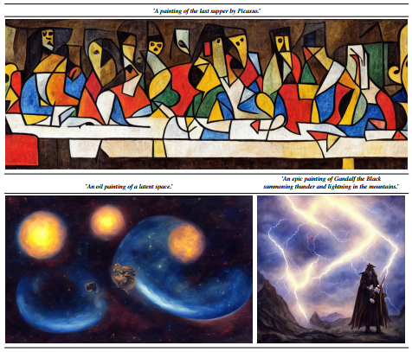
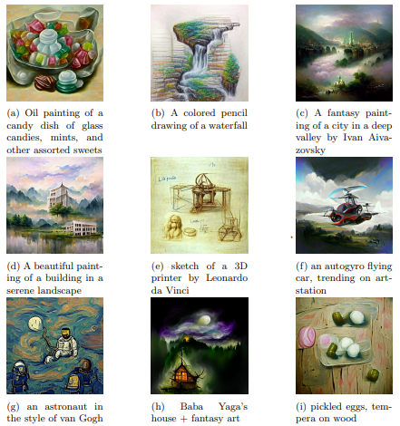
Images Created with VQGAN and Stable Diffusion model
VQGAN
Stable Diffusion Model

Slide 5
How Diffusion Model Works
Diffusion models work by destroying training data by adding noise and then learn to recover the data by reversing this noising process. In Other words, Diffusion models can generate coherent images from noise.
A diffusion model is a two step process:
The forward diffusion process and the reverse process

Slide 6
Forward Diffusion Process
Forward diffusion process in which we add small amount of Gaussian noise to the sample in T steps.

Slide 7
Reverse Process
Reverse process that learns to generate data by denoising.

Slide 8
Why Diffusion Model give better result?(Imagen)
Cascaded Diffusion Model
Pretrained text encoders-T5XXL
Classifier Free Guidance
Dynamic thresholding

Slide 9
Frechlet Inception Distance(FID): Calculate the distance between the feature vectors of real images and the feature vectors of generated images. The lower FID score represents the quality of generated images is higher and similar to the real ones.
Model | FID Score
AttnGAN | 35.49
DF-GAN | 21.42
XMC-GAN | 9.33
DALL-E | 17.89
GLIDE | 12.24
DALL-E 2 | 10.39
Imagen | 7.27

Slide 10
Thanks!

